Slide 1
GitHub issues overview
Issues open discussion threads related to a repo
Bugs, requested features, intended next steps
Anyone can open an issue related to a GitHub repo
Collaborators
External users
Reviewers
Issues are tracked until they are resolved
Many project management features
Notes:
Issues allow us to raise problems/bugs/intended next steps for a codebase.
Issues are useful for:
Organizing and planning your project Communicating with collaborators Peer review Open source development

Slide 2
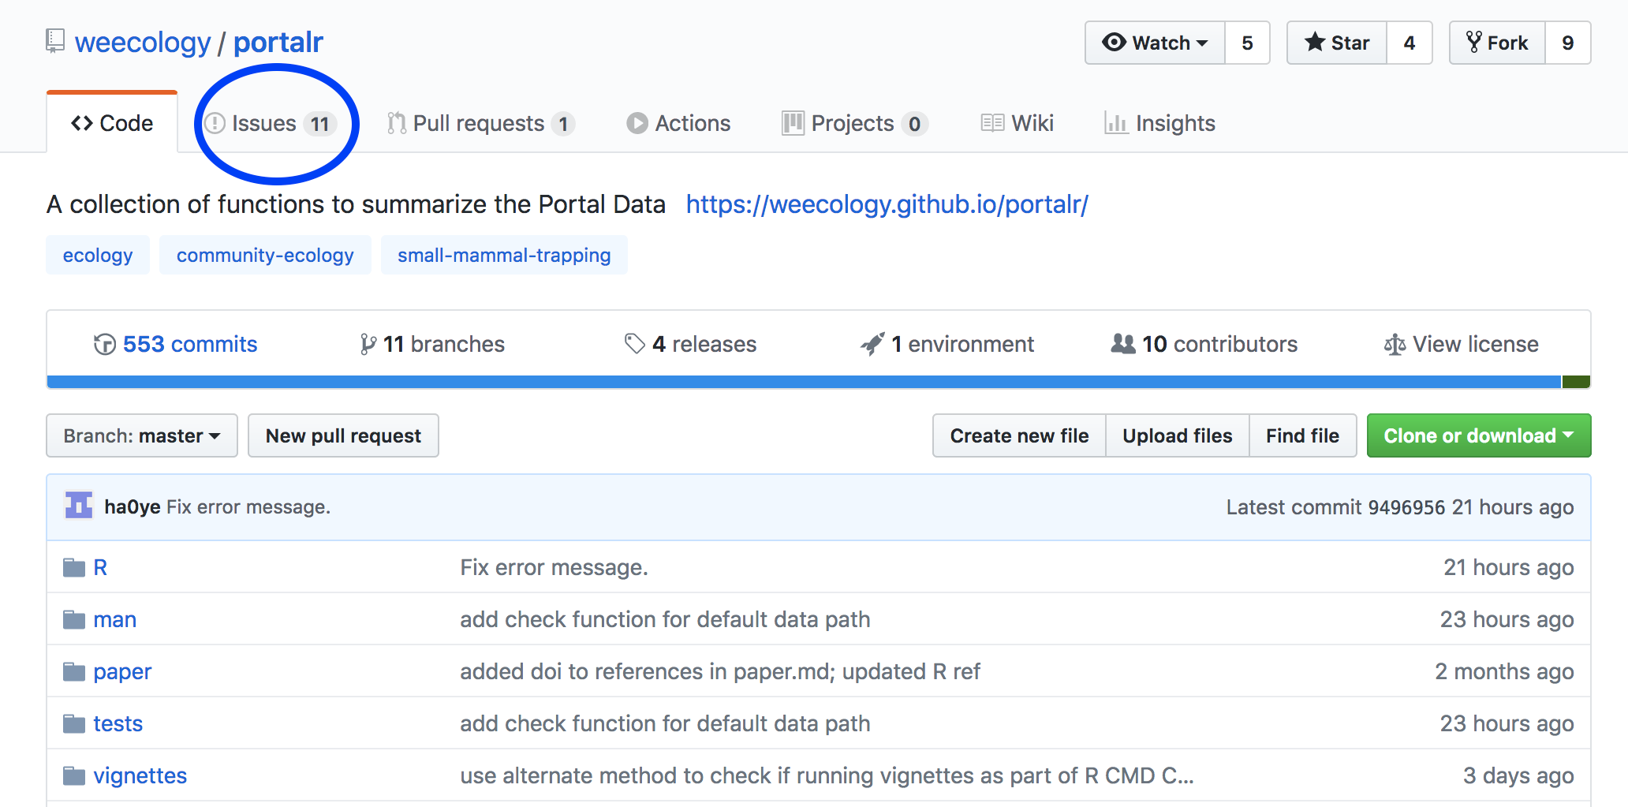

Slide 3
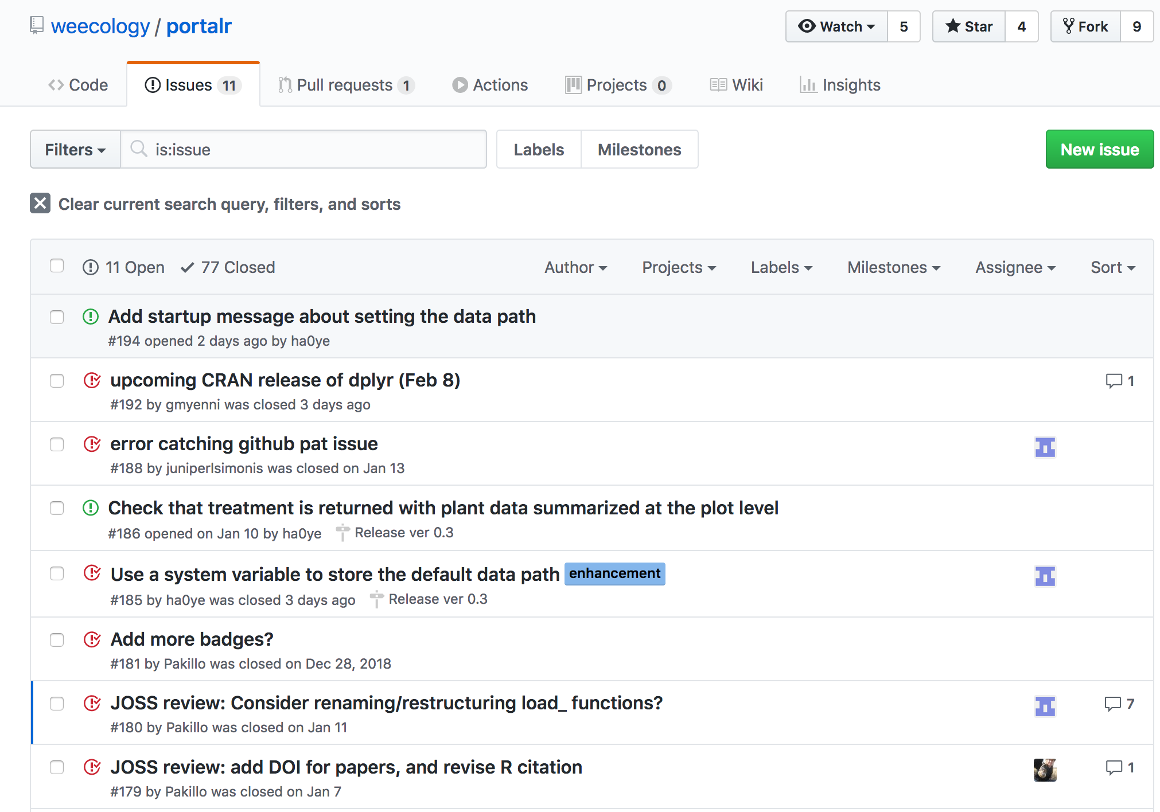

Slide 4
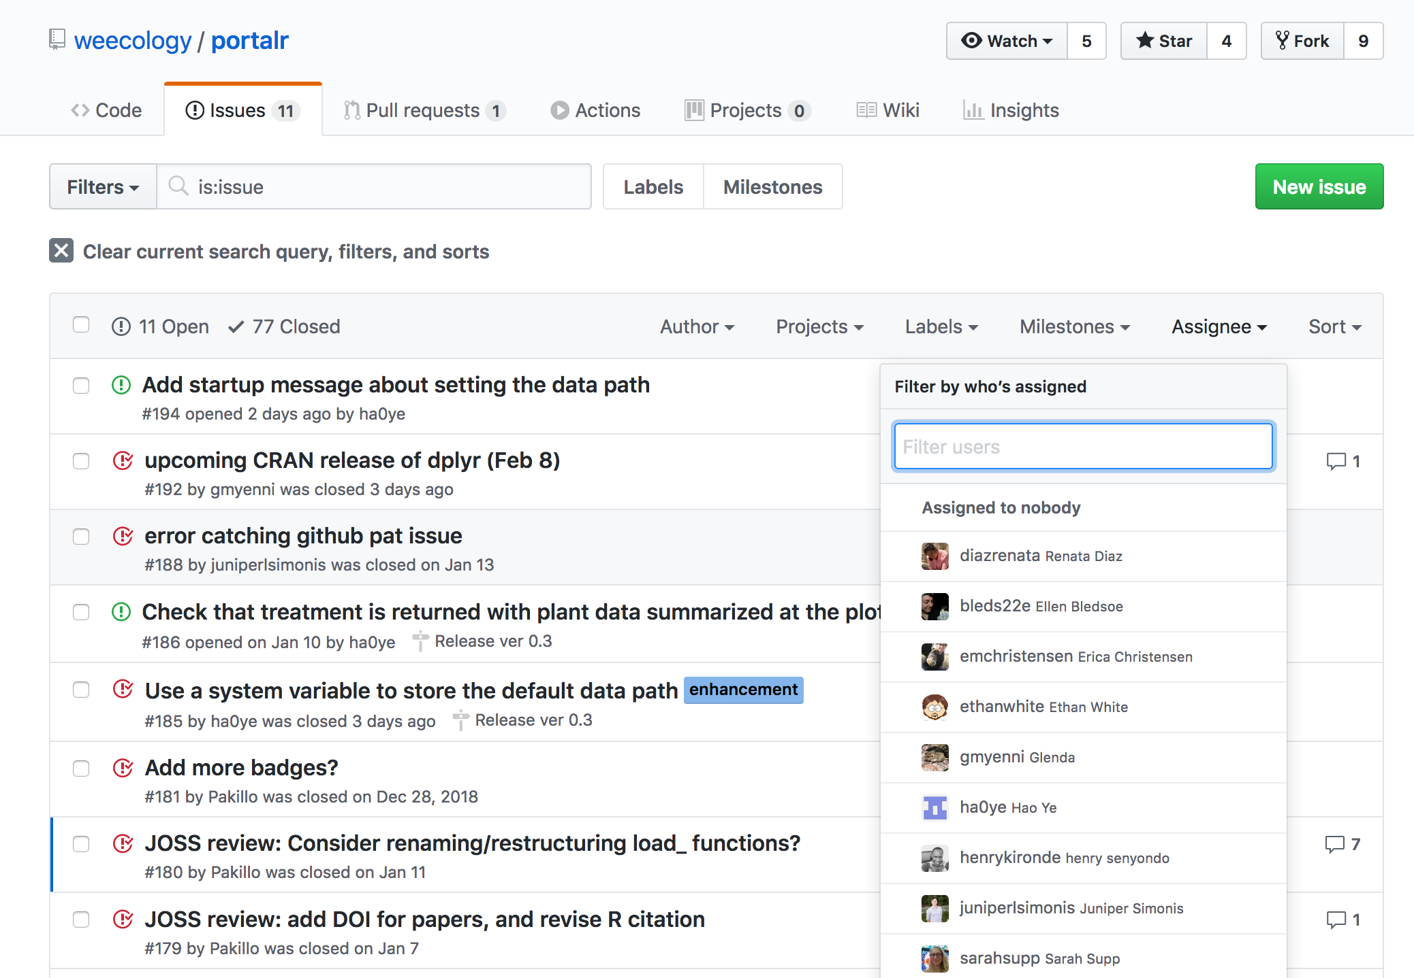
Notes:
Filtering issues - which ones are assigned to me?

Slide 5
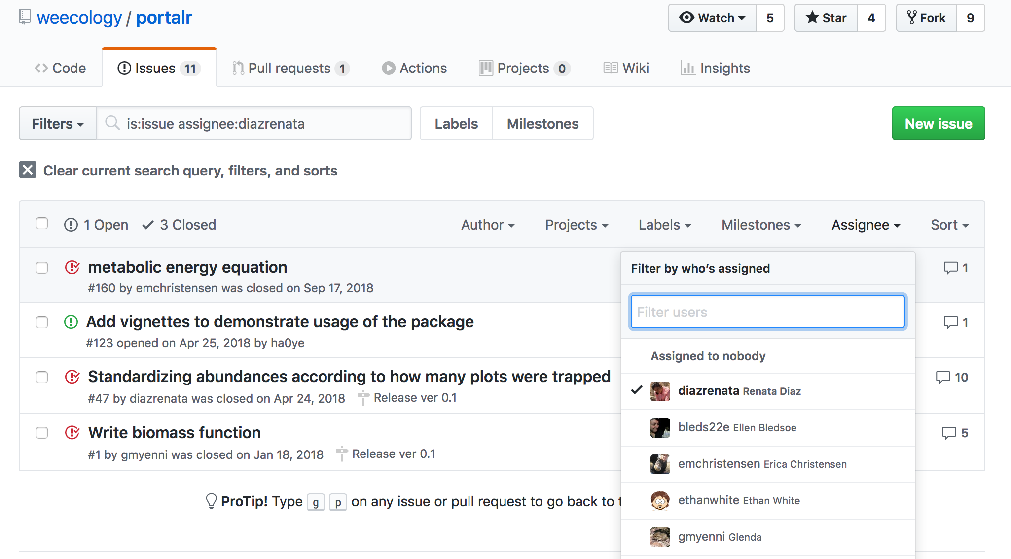
Notes:
Filtering issues - which ones are assigned to me?

Slide 6
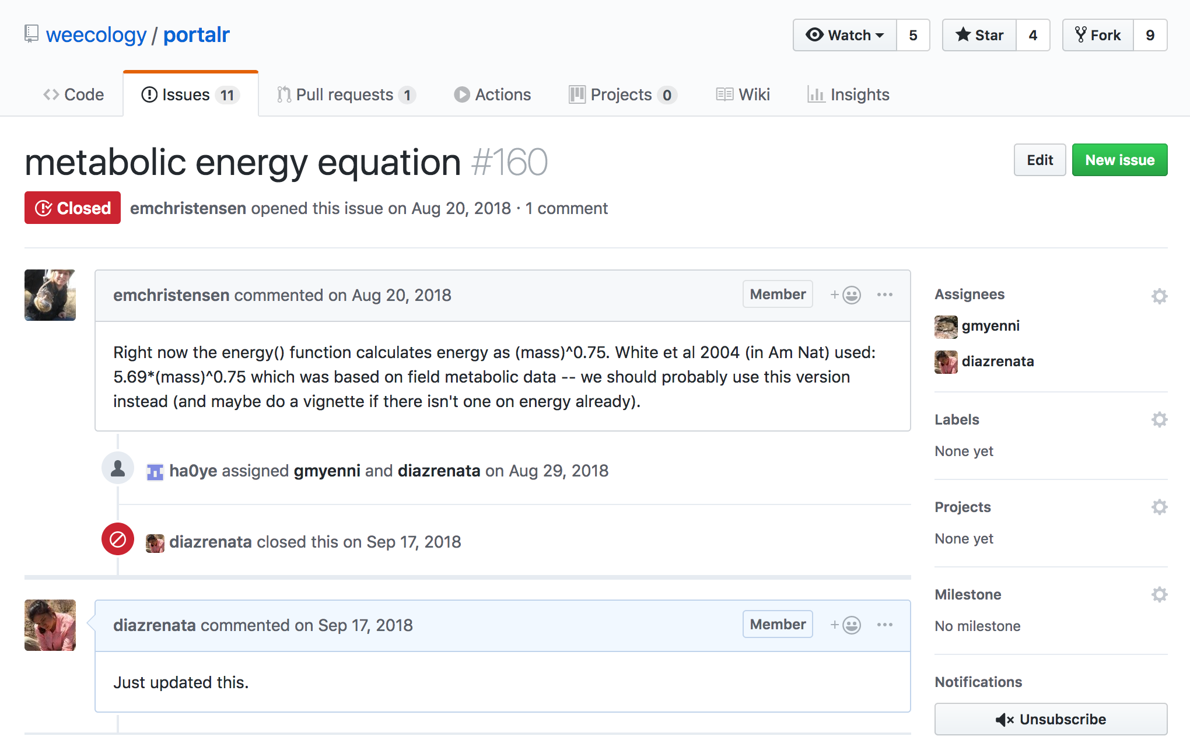
Notes:
Within a team, collaborators can
open issues,
have a conversation about them
Assign them to team members
Track them until they are resolved

Slide 7
Notes:
Peer review

Slide 8
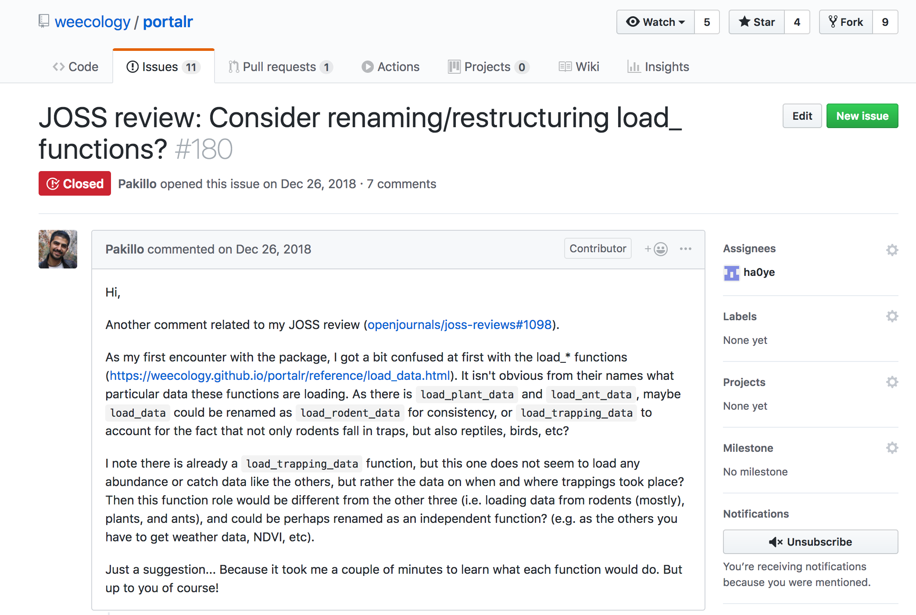
Notes:
Reviewer opened an issue
https://github.com/weecology/portalr/issues/180

Slide 9
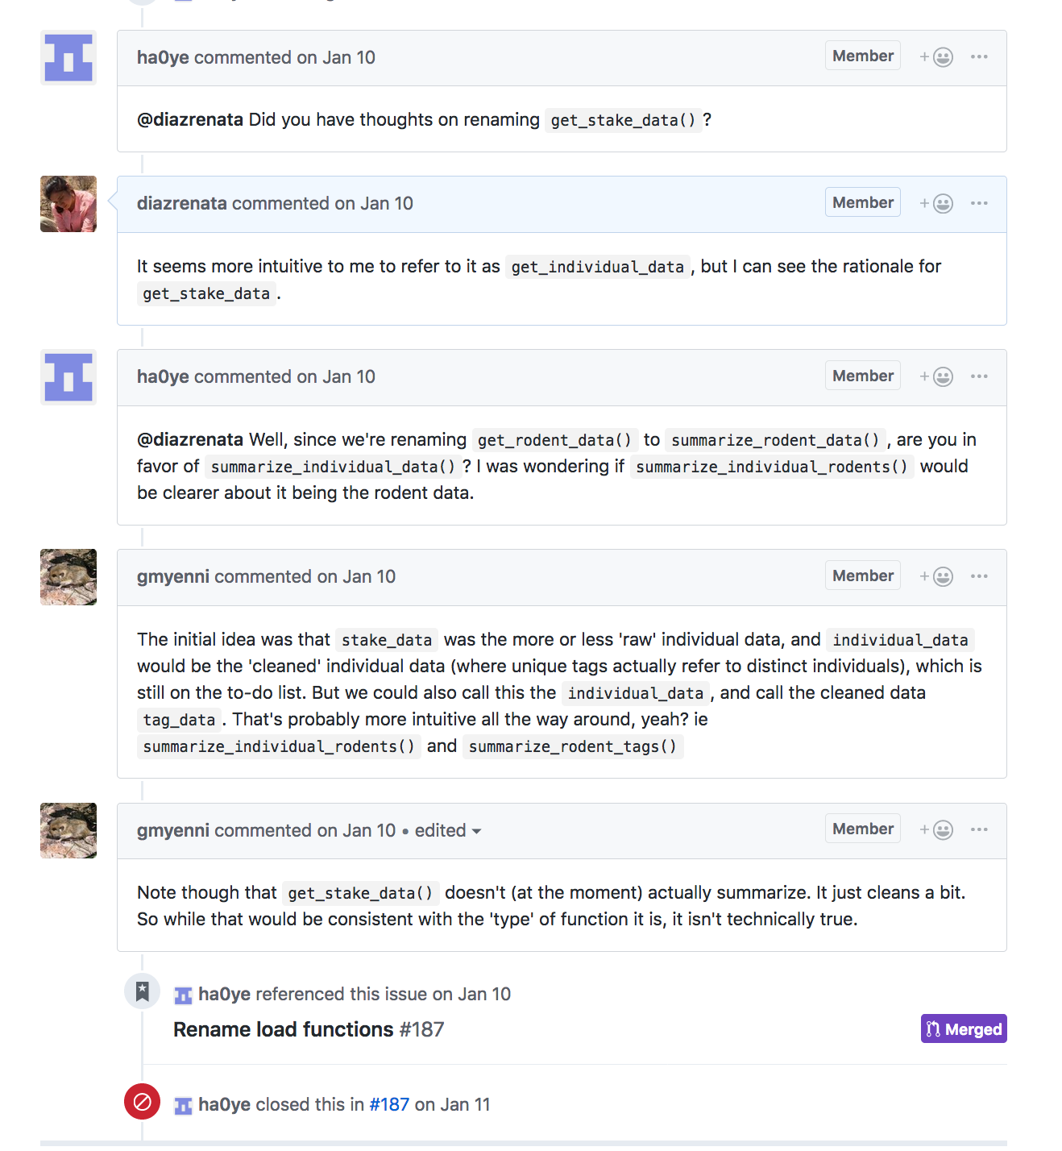
Notes:
Conversation about it

Slide 10
Notes:
Closed via PR

Slide 11
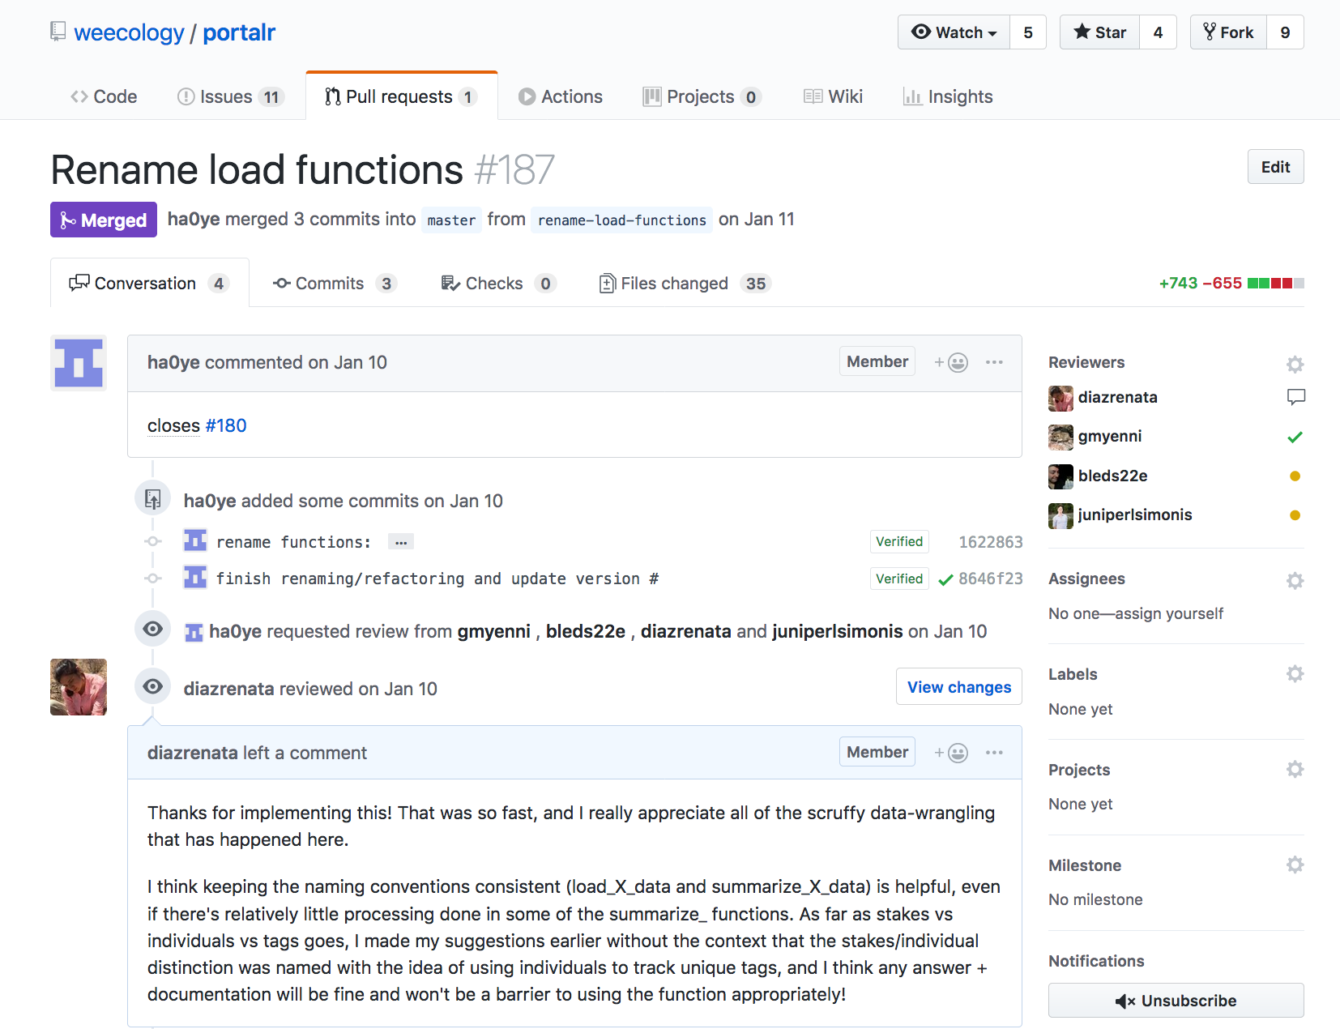
Notes:
This PR closes issue #180
Collaborators reviewed and discussed the PR

Slide 12
Notes:
This PR closes issue #180
Collaborators reviewed and discussed the PR

Slide 13
Notes:
This PR closes issue #180
Collaborators reviewed and discussed the PR

Slide 14
In summary (and beyond!)
Communication
Collaborators
Users of open source software packages
Reviewers
Project management
Issue tracking and resolution
Assignees
Labels and milestones
Project boards

